Slide 1
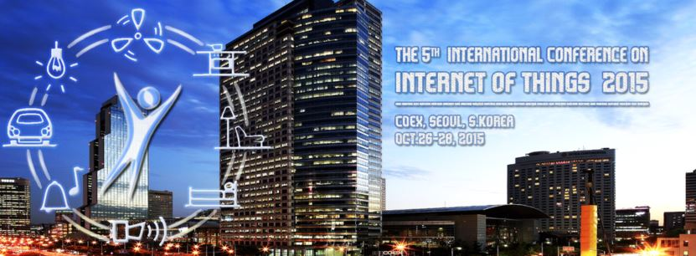
Run-Time knowledge model enrichment in SWoT A step toward ambient services selection relevancy
Gérald Rocher, Jean-Yves Tigli, Stéphane Lavirotte, Rahma Daikhi
Nice Sophia Antipolis University,
CNRS, France
Gerald.Rocher@unice.fr, Jean-Yves.Tigli@unice.fr, Stephane.Lavirotte@unice.fr
10/26/2015

Slide 2
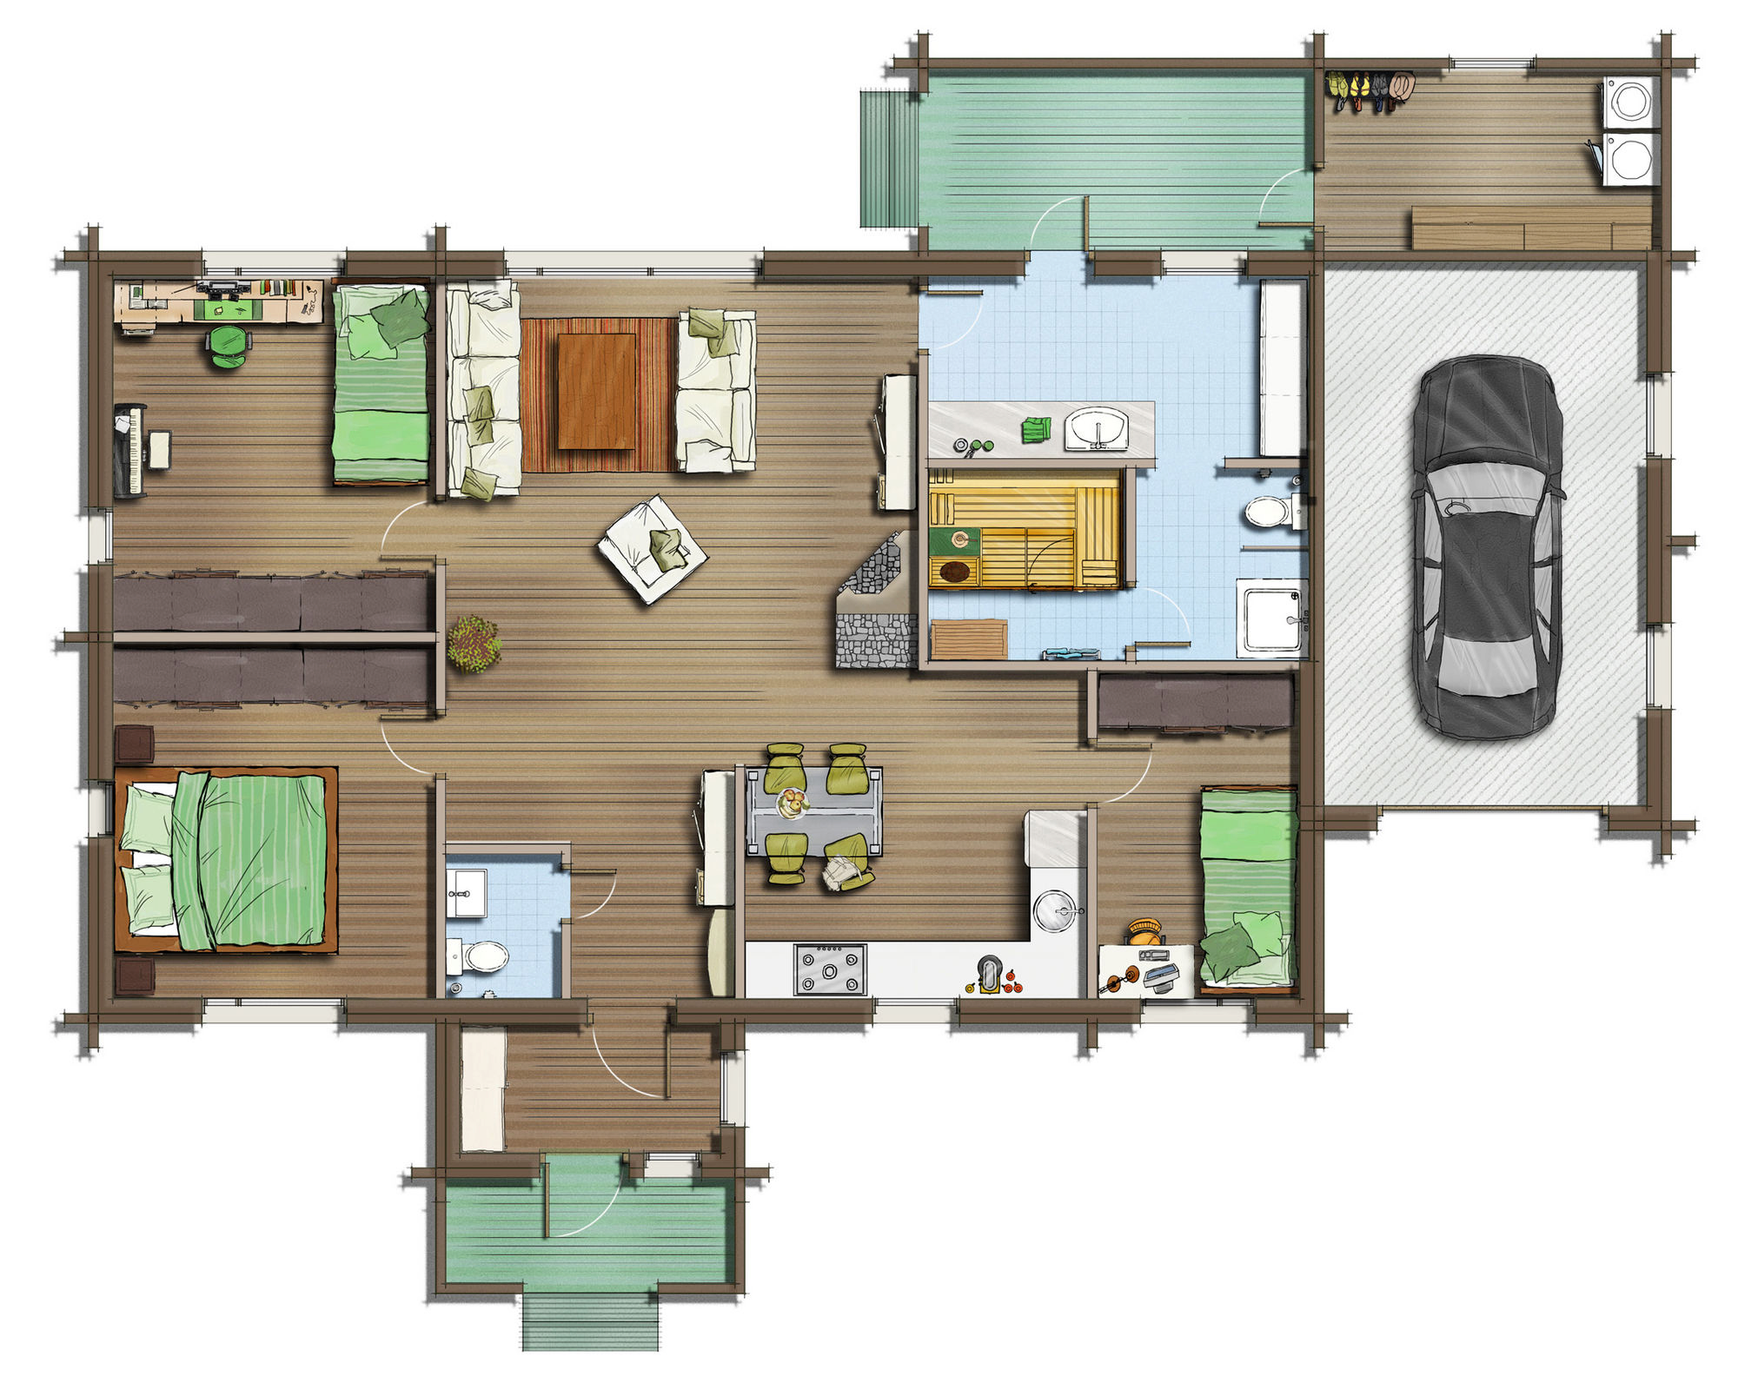
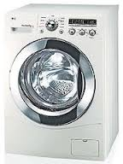
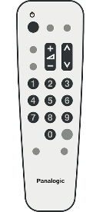
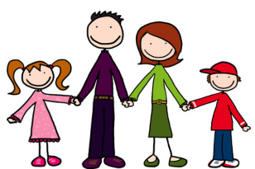
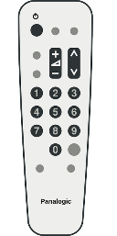
Introduction (1/2)
Environment
Environment configuration
Semantic description
Semantic description
Static
Homogeneous
Semantics
Semantic description
Semantic description
Reasoning
Common Vocabulary
A
P
I
A
P
I
Relies on
Relies on
(Annotation)
Semantic description
Semantic description
Users profiles & Goals
Common Vocabulary
Composition/Application

Slide 3
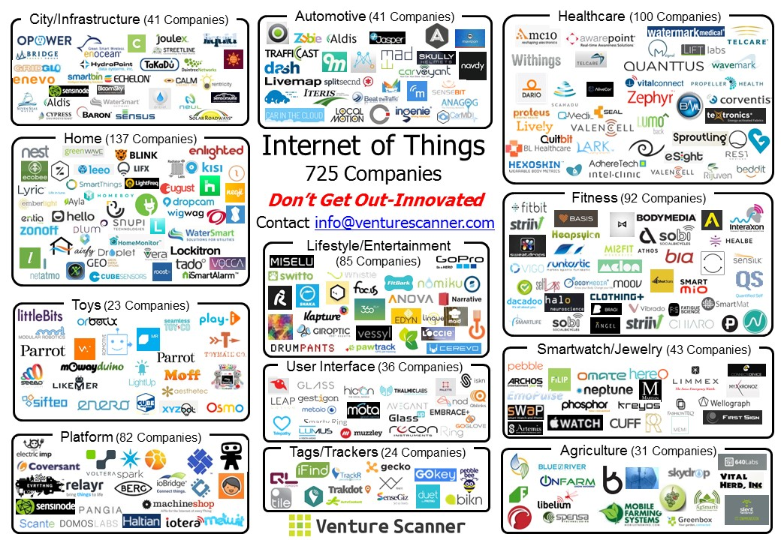
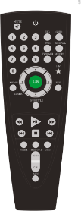
Introduction (2/2)
+
+
+
time
Cyc#0
Cyc#1
Cyc#2
Cyc#3
Cyc#n…
Environment
Environment configuration
Static
Dynamic
Homogeneous
Semantics
We must care about semantic heterogeneity!
Reasoning
Common Vocabulary
A
P
I
A
P
I
Relies on
Relies on
(Annotation)
Semantic description
Semantic description
Users profiles & Goals
Common Vocabulary
Composition/Application

Slide 4
Motivations (1/2)
Environment
Semantic heterogeneity
Semantic description
relies on vocabulary A
Semantic description
relies on vocabulary B
Environment configuration
Static
Dynamic
Homogeneous
Semantic description
relies on vocabulary C
Semantic description
relies on vocabulary D
Semantics
Heterogeneous
Reasoning
Vocabulary A
…
Vocabulary D
A
P
I
A
P
I
Relies on
Relies on
Annotation
Semantic description
…
Semantic description
Users profiles & Goals
Heterogeneous Vocabularies A,B,C,D,…
Composition/Application

Slide 5
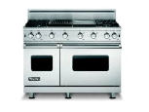
Motivations (2/2)
+
+
-
+
+
time
Cyc#0
Cyc#1
Cyc#2
Cyc#3
Cyc#4
Cyc#5
Cyc#n…
Knowledge enrichment over time
Environment
Environment configuration
Static
Dynamic
Homogeneous
Many opportunities to enrich the knowledge!
Semantics
Heterogeneous
Vocabulary A
…
Vocabulary B
Reasoning
Annotation
Relies on
Relies on
A
P
I
A
P
I
Semantic description
…
Semantic description
Users profiles & Goals
Heterogenous Vocabularies
Composition/Application

Slide 6
Problem statement
A
P
I
A
P
I
Environment
Composition
Static
Dynamic
Homogeneous
System
Selection
Semantics
Heterogeneous
Vocabulary
Device
AirConditioner
RemoteControl
Annotations
RemoteControl(rc_1)
…
+
AirConditioner(ac_1)
…
+
Environment

Slide 7
Problem statement
Environment
Composition
Static
Dynamic
Homogeneous
System
Selection
Semantics
Heterogeneous
Heterogeneous vocabularies
Device
Appliance
Vocabulary
AirConditioner
RemoteControl
Climatization
Annotations
RemoteControl(rc_1)
…
+
Climatization(clz_1)
…
+
Environment

Slide 8
Problem statement
NONE
Environment
Composition
Static
Dynamic
Homogeneous
System
Selection
Semantics
Heterogeneous
Heterogeneous vocabularies
Device
Appliance
AirConditioner
RemoteControl
Climatization
Annotations
RemoteControl(rc_1)
…
+
Climatization(clz_1)
…
+
Environment

Slide 9
Semantic Web : Conceptual Foundations
Environment
Static
Dynamic
Homogeneous
$Knowledge base Σ=\left\langle TBox, ABox\right\rangle$
Semantics
${TBox}_{\left(n\right)}=\left\langle \left\{{Concepts}_{\left(n\right)}\right\},\left\{{Roles}_{\left(t\right)}\right\}\right\rangle$, is the vocabulary (ontology).
${ABox}_{\left(n\right)}=\left\langle \left\{{Concept Assertions}_{\left(n\right)}\right\},\left\{{Role Assertions}_{\left(n\right)}\right\}\right\rangle$, are the assertions.
$${TBox}_{\left(n\right)}$$
Σ
uri1:Device
has_manufacturer
uri1:Manufacturer
domain
range
System
rdfs:subClassOf
rdfs:subClassOf
uri1:RemoteControl
uri1:AirConditioner
rdf:type
rdf:type
has_manufacturer
$${ABox}_{\left(n\right)}$$
uri1:rc_1
uri1:Samsung
Annotations
+
Env.
$$ABox$$

Slide 10
Knowledge integration
Environment
Static
Dynamic
Homogeneous
Semantics
${ABox}_{\left(n^{′}\right)}=\left\langle \left\{{CA}_{\left(n\right)}+new CA\right\},\left\{{RA}_{\left(n\right)}+new RA\right\}\right\rangle$
Heterogeneous
${TBox}_{\left(n^{′}\right)}=\left\langle \left\{{Concepts}_{\left(n\right)}+new Concepts\right\},\left\{{roles}_{\left(n\right)}+new Roles\right\}\right\rangle$
$${TBox}_{\left(n^{′}\right)}$$
Σ
manufactured_by
+
uri2:Appliance
uri2:Manufacturer
$${TBox}_{\left(n\right)}$$
System
rdfs:subClassOf
domain
range
uri2:Climatization
$${ABox}_{\left(n\right)}$$
+
rdf:type
$${ABox}_{\left(n′\right)}$$
uri2:clz_1
Annotations
$$ABox$$
+
$$TBox, ABox$$
Env.

Slide 11
Knowledge alignments
Environment
Static
Dynamic
Well addressed problem [Euzenat et al.]
Homogeneous
Semantics
Heterogeneous
${ABox}_{\left(n^{′′}\right)}={ABox}_{\left(n^{′}\right)}$
${TBox}_{\left(n^{′′}\right)}=\left\langle \left\{{Concepts}_{\left(n^{′}\right)}+{Concepts}_{(align.)} \right\},\left\{{roles}_{\left(n^{′}\right)}+{Roles}_{(align.)}\right\}\right\rangle$
$${TBox}_{\left(n^{′′}\right)}$$
Σ
owl:equivalentClass
$${TBox}_{\left(n^{′}\right)}$$
+
uri1:AirConditioner
uri2:Climatization
has_manufacturer
…
owl:equivalentProperty
manufactured_by
System
$${ABox}_{\left(n^{′}\right)}$$
$${ABox}_{\left(n^{′′}\right)}$$
Annotations
$$ABox$$
$$TBox, ABox$$
Env.

Slide 12
Knowledge reasoning
${ABox}_{\left(n+1\right)}=\left\langle \left\{{CA}_{\left(n^{′′}\right)}+{CA}_{\left(infered.\right)}\right\},\left\{{RA}_{\left(n+2\right)}+{RA}_{\left(infered\right)}\right\}\right\rangle$
${TBox}_{\left(n+1\right)}=\left\langle \left\{{Concepts}_{\left(n^{′′}\right)}+{Concepts}_{\left(infered\right)}\right\},\left\{{Roles}_{\left(n^{′′}\right)}+ {Roles}_{(infered)}\right\}\right\rangle$
$${TBox}_{\left(n+1\right)}$$
rdfs:subClassOf
+
uri2:Climatization
uri1:Device
Σ
$${TBox}_{\left(n^{′′}\right)}$$
rdfs:subClassOf
System
uri1:AirConditioner
uri2:Appliance
…
$${ABox}_{\left(n^{′′}\right)}$$
+
clz_1
rdf:type
uri1:AirConditioner
…
$${ABox}_{\left(n+1\right)}$$
Annotations
$$ABox$$
$$TBox, ABox$$
Env.

Slide 13
𝑨𝑩𝒐𝒙 removal @run-time (𝑻𝑩𝒐𝒙 is made persistent)
${ABox}_{\left(n+1\right)}=\left\langle \left\{{CA}_{\left(n\right)}−{CA}_{\left(removed device\right)}\right\},\left\{{RA}_{\left(n\right)}−{RA}_{\left(removed device\right)}\right\}\right\rangle$
${TBox}_{\left(n+1\right)}={TBox}_{(n)}$
$${TBox}_{\left(n+1\right)}$$
Σ
$${TBox}_{\left(n\right)}$$
System
-
uri2:Climatization
rdf:type
clz_1
$${ABox}_{\left(n+1\right)}$$
$${ABox}_{\left(n\right)}$$
uri1:AirConditioner
rdf:type
clz_1
Annotations
$$ABox$$
$$TBox, ABox$$
Env.

Slide 14
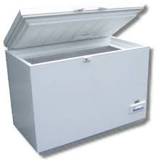
Selection relevancy improvement over time
Devices offering food preservation?
Selection (KB queries)
No answer
Appliance
$$TBox$$
Service
rdfs:subClassOf
rdfs:subClassOf
Formal knowledge representation & reasoning
ex:offers
System
Freezing
Deep freezer
rdf:type
DF_1
$$ABox$$
Home
Shop
Friend
Env.
1/ Home

Slide 15
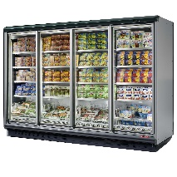
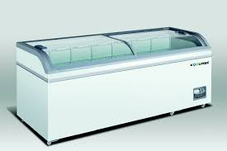
Selection relevancy improvement over time
Devices offering food preservation?
Selection (KB queries)
DF_2
Appliance
$$TBox$$
Service
rdfs:subClassOf
rdfs:subClassOf
Formal knowledge representation & reasoning
ex:offers
System
Freezing
Deep freezer
rdfs:subClassOf
rdfs:subClassOf
ex:offers
Fridge
Food preservation
rdf:type
rdf:type
$$ABox$$
DF_2
F_1
Home
Shop
Friend
Env.
2/ Shop

Slide 16
Selection relevancy improvement over time
Devices offering food preservation?
Selection (KB queries)
DF_1
Appliance
$$TBox$$
Service
rdfs:subClassOf
rdfs:subClassOf
Formal knowledge representation & reasoning
ex:offers
System
Freezing
Deep freezer
rdfs:subClassOf
rdfs:subClassOf
ex:offers
Fridge
Food preservation
rdf:type
DF_1
$$ABox$$
Home
Shop
Friend
Env.
3/ Back to home

Slide 17
Selection relevancy improvement over time
Devices offering food preservation?
Selection (KB queries)
F_2
Appliance
$$TBox$$
Service
rdfs:subClassOf
rdfs:subClassOf
rdfs:subClassOf
ex:offers
Formal knowledge representation & reasoning
Freezing
Deep freezer
rdfs:subClassOf
System
rdfs:subClassOf
ex:offers
ex:offers
Cooling
Fridge
Food preservation
ex:offers
rdf:type
F_2
$$ABox$$
Home
Shop
Friend
Env.
4/ Friend

Slide 18
Selection relevancy improvement over time
Devices offering food preservation?
Selection (KB queries)
DF_2, F_1
Appliance
$$TBox$$
Service
rdfs:subClassOf
rdfs:subClassOf
rdfs:subClassOf
ex:offers
Formal knowledge representation & reasoning
Freezing
Deep freezer
rdfs:subClassOf
System
rdfs:subClassOf
ex:offers
ex:offers
Cooling
Fridge
Food preservation
ex:offers
rdf:type
rdf:type
$$ABox$$
DF_2
F_1
Home
Shop
Friend
Env.
5/ Back to shop

Slide 19
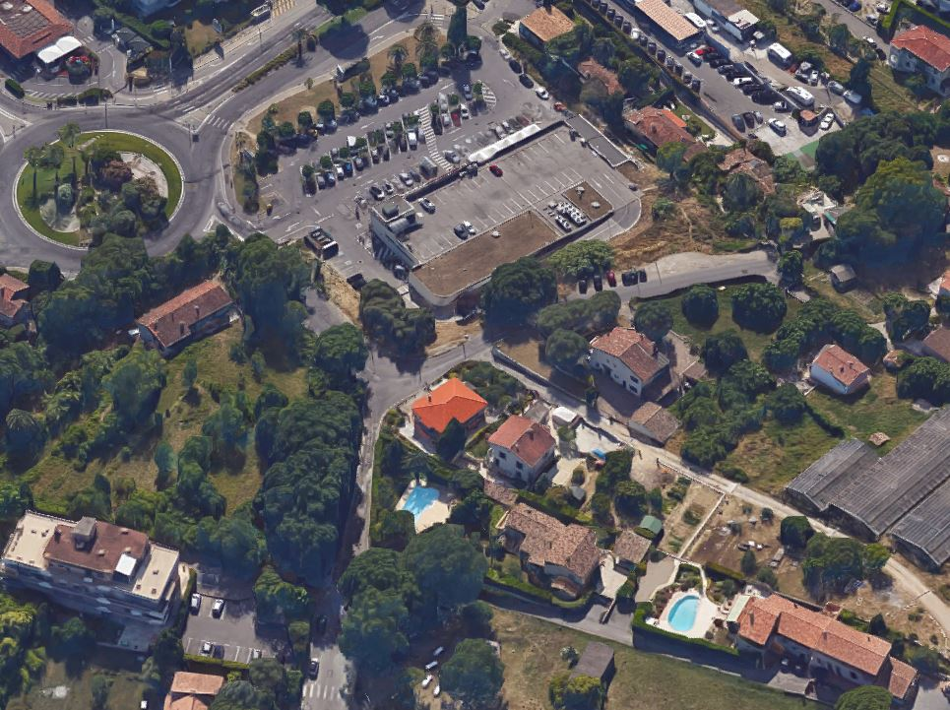
Experimentations
A validation platform:
Web services for devices (UPnP),
Jena API (Knowledge base),
Dogont ontology
Fragmented,
Degraded.
Scenario:
Shop
Home
Friend

Slide 20
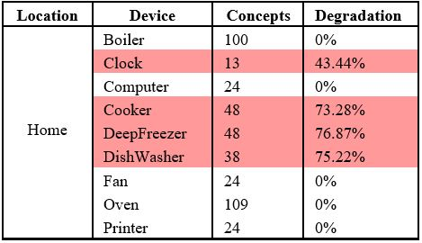
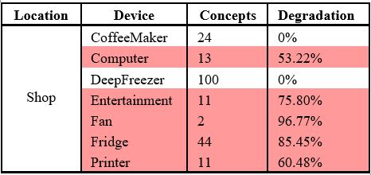
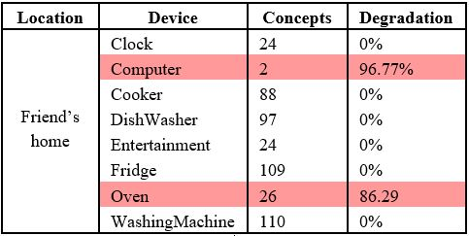
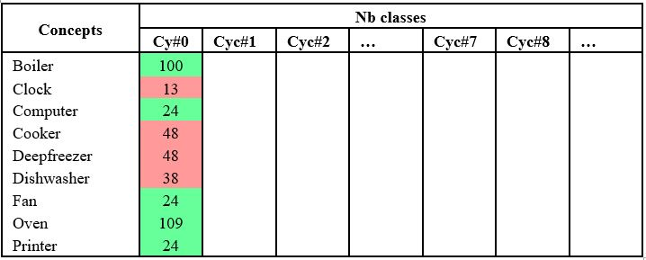
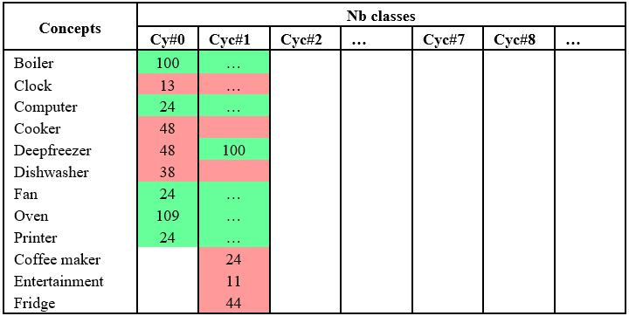
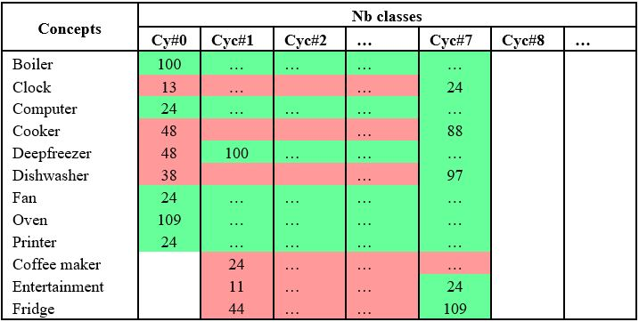
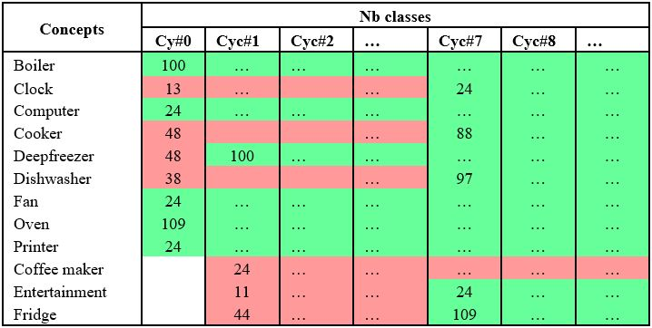
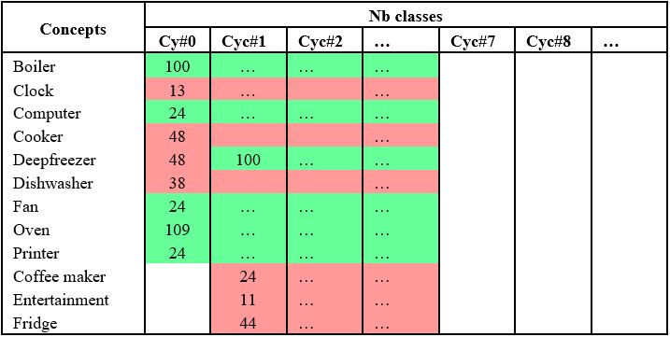
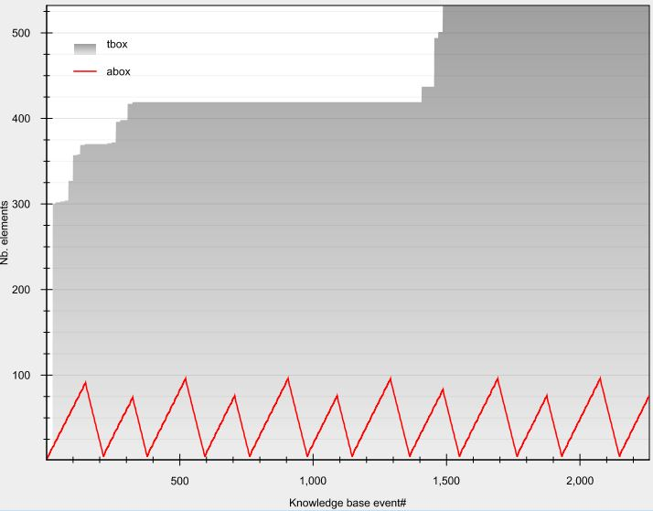
Experimentations
Knowledge base content evolution over time
Cy#0
Cy#1
Cy#2
Cy#3
Cy#4
Cy#5
Cy#6
Cy#7
Cy#8
Cy#9
Cy#10
…
Friend
Home
Home
Home
Home
Home
Home
Shop
Shop
Shop
Shop
Shop

Slide 21
Conclusion
We presented a model…
Environment
Managing devices semantic heterogeneity
Allowing cross-domains SWoT applications….
Leveraging devices dynamicity
System vocabulary and reasoning capability are increased over time…
Static
Dynamic
Homogeneous
(domain specific)
Semantics
Heterogeneous
(cross-domains)

Slide 22
Run-Time knowledge model enrichment in SWoT A step toward ambient services selection relevancy
Questions?
Gérald Rocher, Jean-Yves Tigli, Stéphane Lavirotte, Rahma Daikhi
Nice Sophia Antipolis University,
CNRS, France
Gerald.Rocher@unice.fr, Jean-Yves.Tigli@unice.fr, Stephane.Lavirotte@unice.fr
10/26/2015

