Slide 1
Run-Time knowledge model enrichment in SWoT
A step toward ambient services selection relevancy
Gérald Rocher, Jean-Yves Tigli, Stéphane Lavirotte, Rahma Daikhi
Lundi 29 Juin 2015

Slide 2
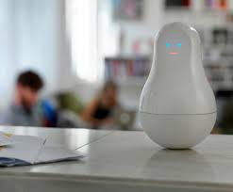
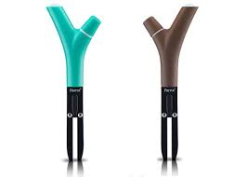
Introduction (1/2)
Many devices integrated in everyday life physical objects (chair, table, lamp, etc…) and physical environments (house, building, vehicle, etc…) → Ambient environments
Devices implement resources interacting with objects (actuator) and/or gathering data (sensor) accessible from services,
Services are selected by ambient applications that make them work in concert to assist users in several distinct domains (healthcare, smart houses, smart cities, etc…).

Slide 3
Introduction (2/2)
Devices cooperation requires a strong operability
Work on communication protocols (IoT, Internet of Things) to cope with technological heterogeneity
→ Web services approach (WS-*, RESTful) are widely accepted (WoT, Web of Things).
With this hypothesis, we can now focus at addressing the devices semantic heterogeneity
Devices and services are annotated with metadata,
Goal : services selection relevancy improvement.

Slide 4
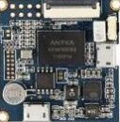
Annotation usage trend (1/2)
Smart energy
Device and services contextual information (location, temperature, …), structural (type, size,…) and functional descriptions (display video, …)
Health care
Smart cities
Smart office
Application / Domain specific ontologies
Sensors
Smart home
Upper Ontology-based
Security
Taxonomy-based
Typed data
Σ
Σ
Relational
DB
Knowledge
base
Reasoning
Σ
Selection from regular expressions…
Selection from queries
Selection from queries
From WoT …
… to SWoT (Semantic Web of Things)

Slide 5
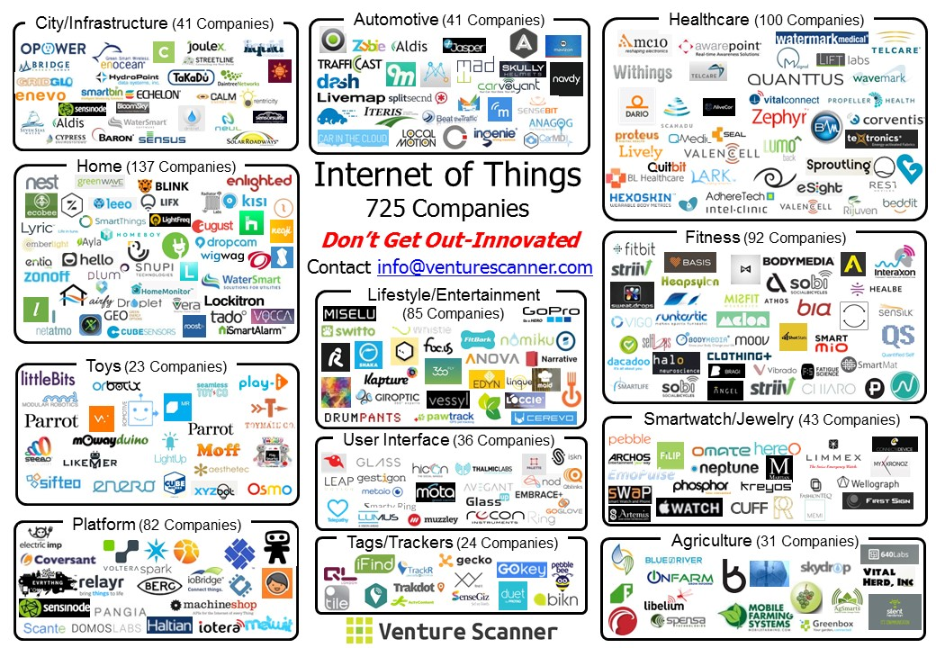
Many potential devices manufacturers
Most current works rely on static and ad-hoc knowledge model
Good at managing semantic heterogeneity
But there is not knowledge model describing the world!
We do foresee that manufacturers will independently develop their own ontologies to describe their devices…
Development of a comprehensive ontology from heterogeneous ontologies is unlikely to happen…
Devices in the environment are not known @design time → need for an knowledge model enrichment @run time.

Slide 6
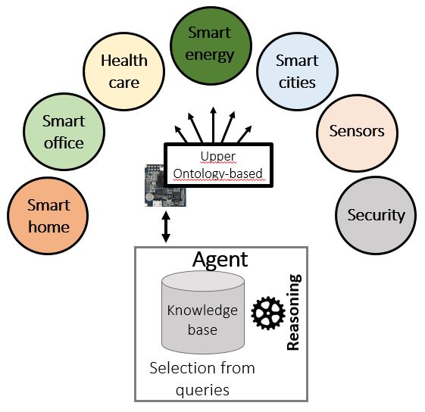
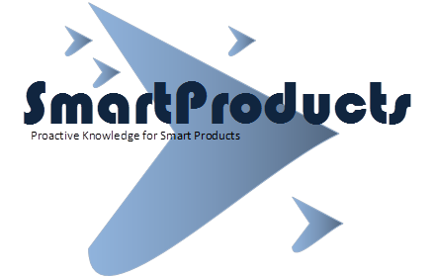
Some knowledge enrichment approaches
Smart energy
Heterogeneous ontologies
Health care
Smart cities
Smart office
Sensors
Smart home
Upper Ontology-based
Security
Run time Alignments…
Σ
Σ
Users’ feedback
Upper ontology
Knowledge
base
Reasoning
Users’ profile
Knowledge
base
Reasoning
Users’ preference
Selection from queries
Selection from queries
Knowledge sharing …
… Users’ information integration over time

Slide 7
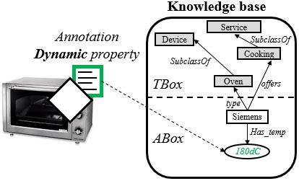
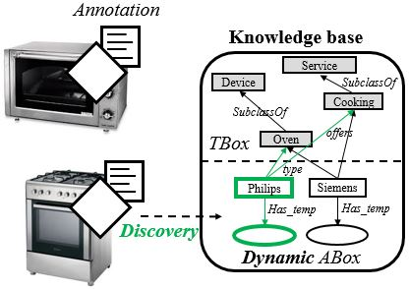
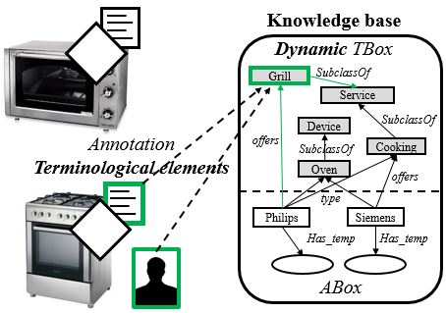
SWoT knowledge model dynamicity levels
Property level
What is the current temperature of the oven ?
Instance level
What are currently the appliances present in the kitchen?
Terminological level
What are the domestic appliances available to grill?

Slide 8
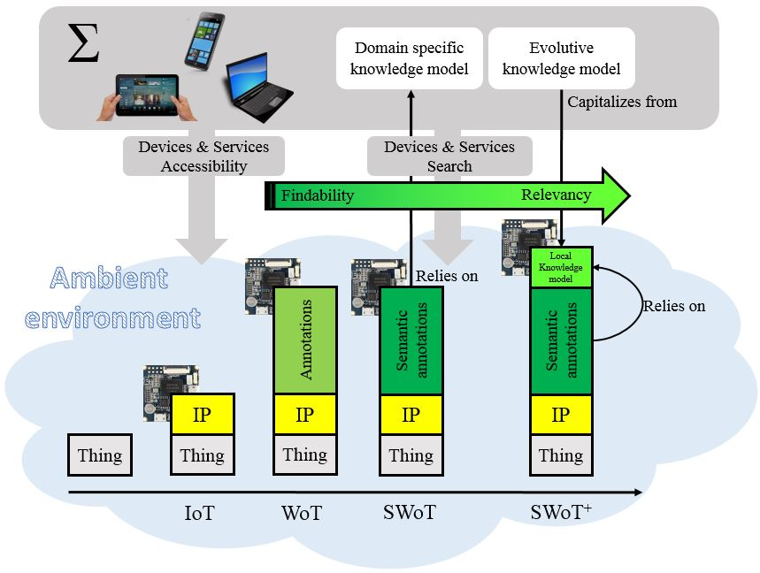
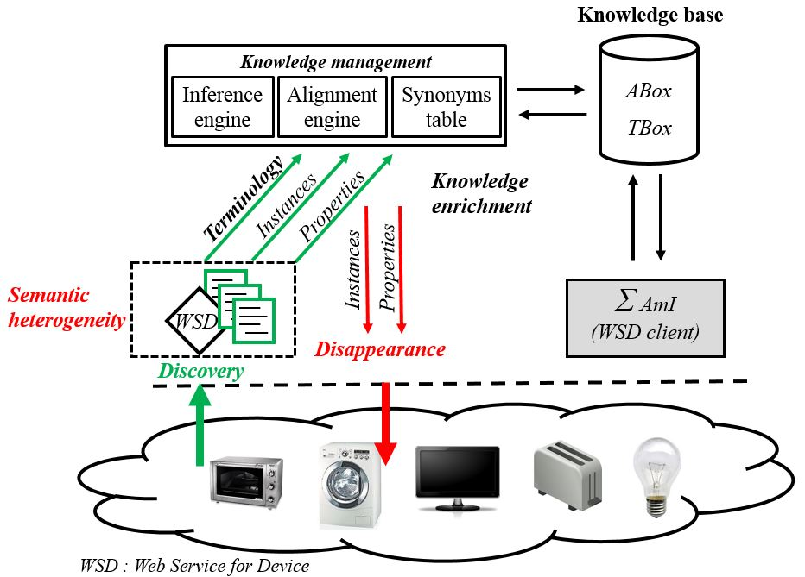
SWoT⁺ : knowledge model enrichment @run-time
By leveraging the terminological dynamicity level
WWW
Queries

Slide 9
Research challenges…
Property dynamicity level
Knowledge contextualization,
Data analytics.
Knowledge base content maintenance
Model validity over time,
Inference rules and inferred facts management.
No available dataset to date
project provides some datasets but are mostly “raw” data, not ontological fragments.

Slide 10
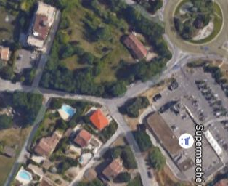
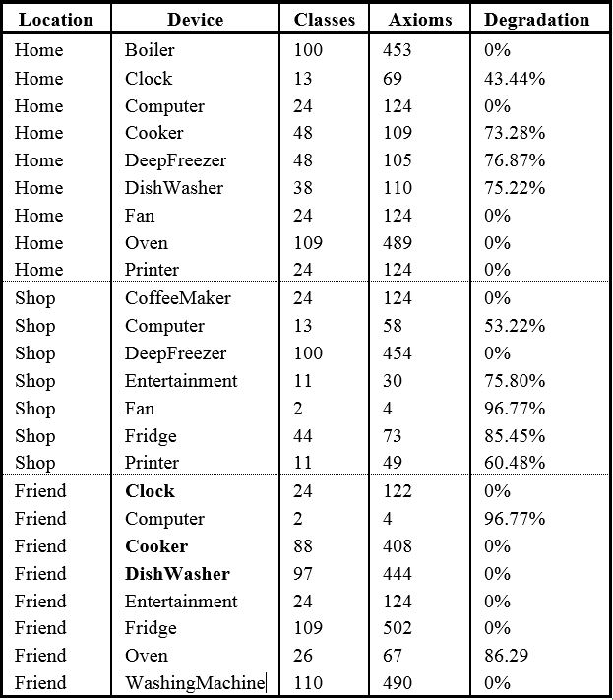
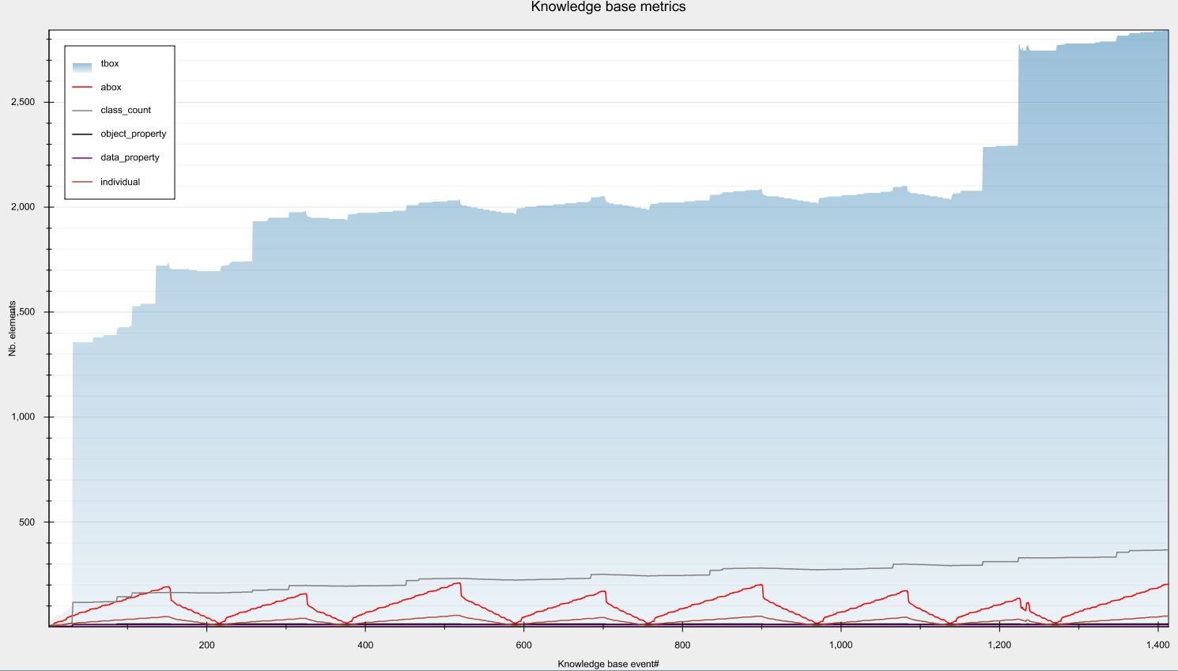
Use-case#1 : Assisted living
Elderly’s home
Friend’s home
Marketplace
Friend’s Home
New environment brings new knowledge model…
While in the same environment there is no knowledge model evolution…

Slide 11
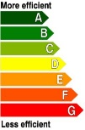
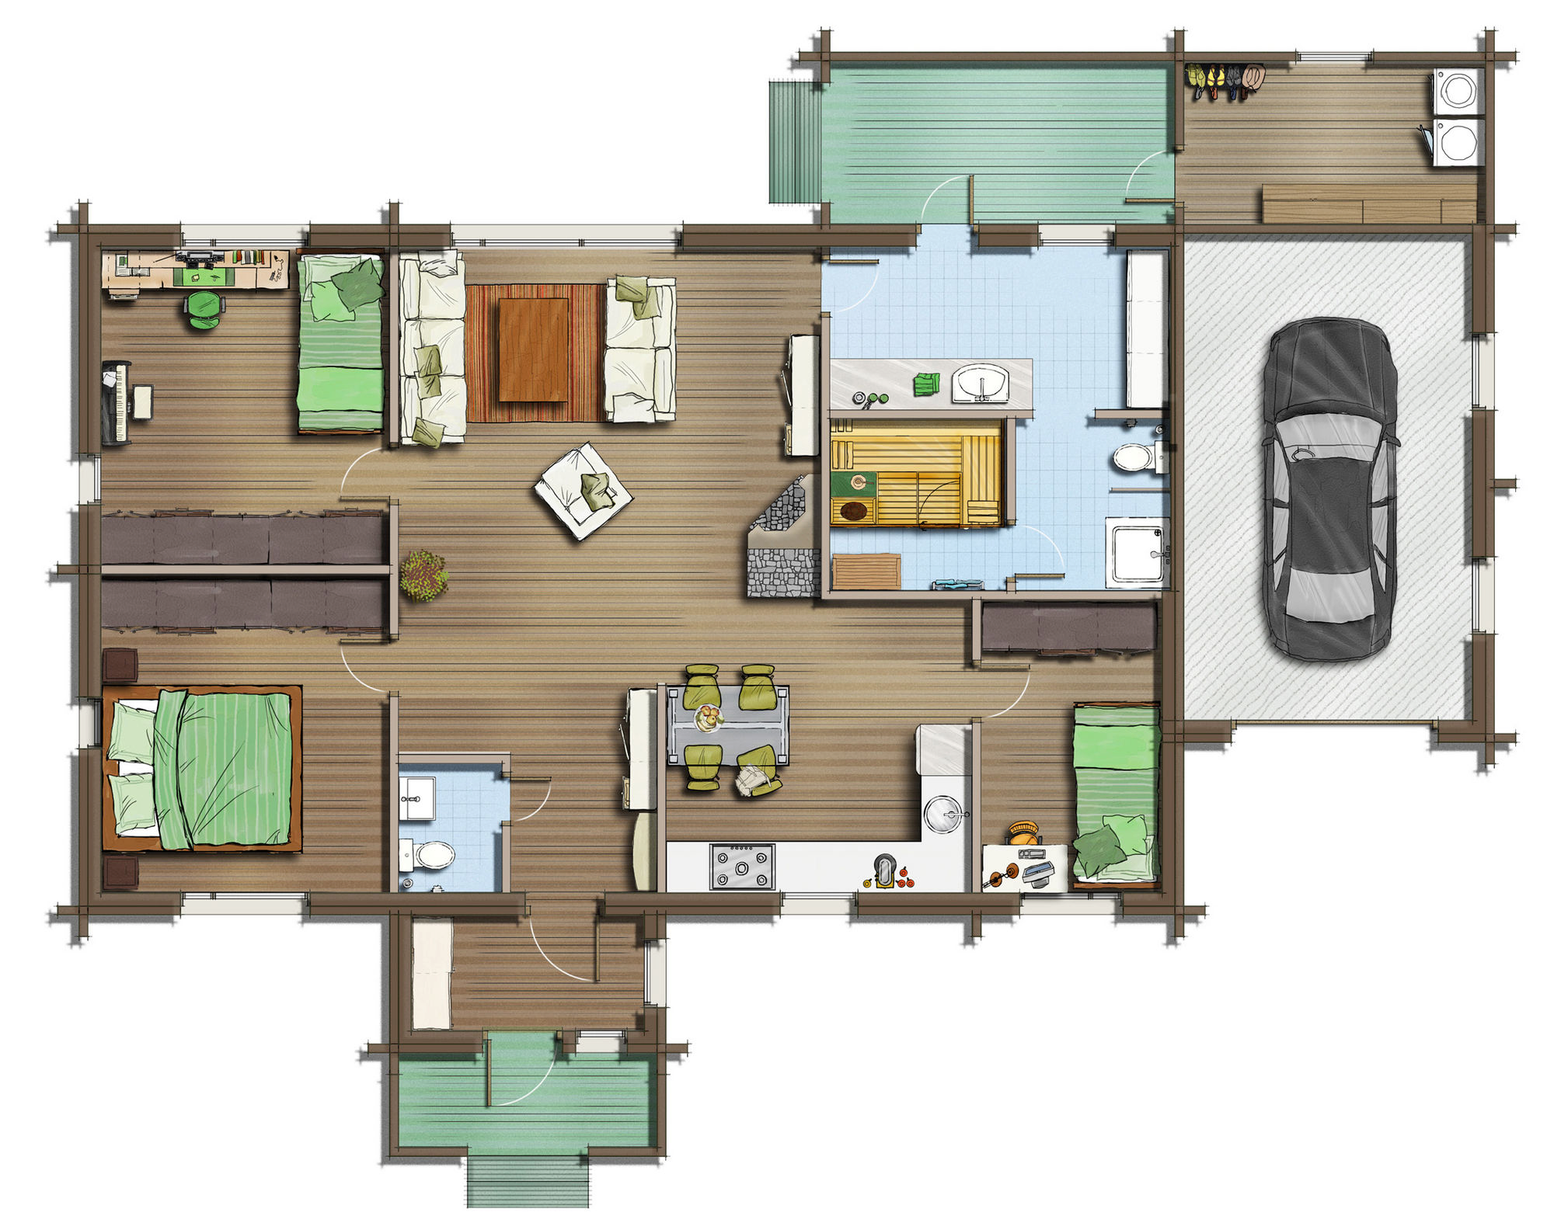
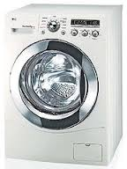
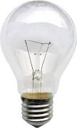
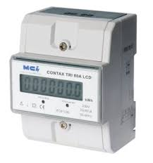
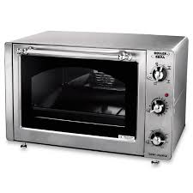
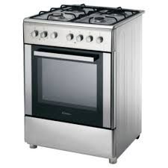
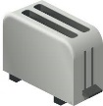
Use-case#2 : Energy consumption optimization
193kwH
An electricity meter is added in the environment…
60W
60W
60W
40W
900W
20W
20W
3000W
1000W
60W
It brings inference rules…
… to compute a new power consumption label property from raw device power consumption property

Slide 12
Collaborations in progress…
(Tunisia) : Dataset creation
Ontologies modeling from manufacturers devices specifications,
Advanced linked data usage for automatic generation.
(Italy) : Equipment loan
toolkit

Slide 13
References
Poster submission (UBIComp 2015)
Better Assist People Through Knowledge Capitalization in Ambient Environments [G.Rocher; J.Y Tigli; S.Lavirotte; R.Daikhi]
https://hal.archives-ouvertes.fr/hal-01168568
Paper submission (IoT 2015)
Run-Time knowledge model enrichment in SWoT, A step toward ambient services selection relevancy [G.Rocher; J.Y Tigli; S.Lavirotte; R.Daikhi]
https://hal.archives-ouvertes.fr/hal-01168411

Slide 14
Backup

Slide 15
Semantic Web technologies
Device
User
subClassOf
has_location
is_in
Ontologies
Formal knowledge description model
OWL (Ontology Web Language)
Knowledge base
Contains terminological elements (TBox) along with instances (ABox),
Reasoning and inference capabilities,
Query engine (SPARQL).
Display
Location
subClassOf
subClassOf
TV
Tablet
Device
User
subClassOf
has_location
is_in
type
Display
Location
Bob
subClassOf
subClassOf
type
is_in
TV
Tablet
type
type
type
type
TV_1
Tab_1
Tab_2
Kitchen
Livingroom
has_location
has_location
has_location

Slide 16
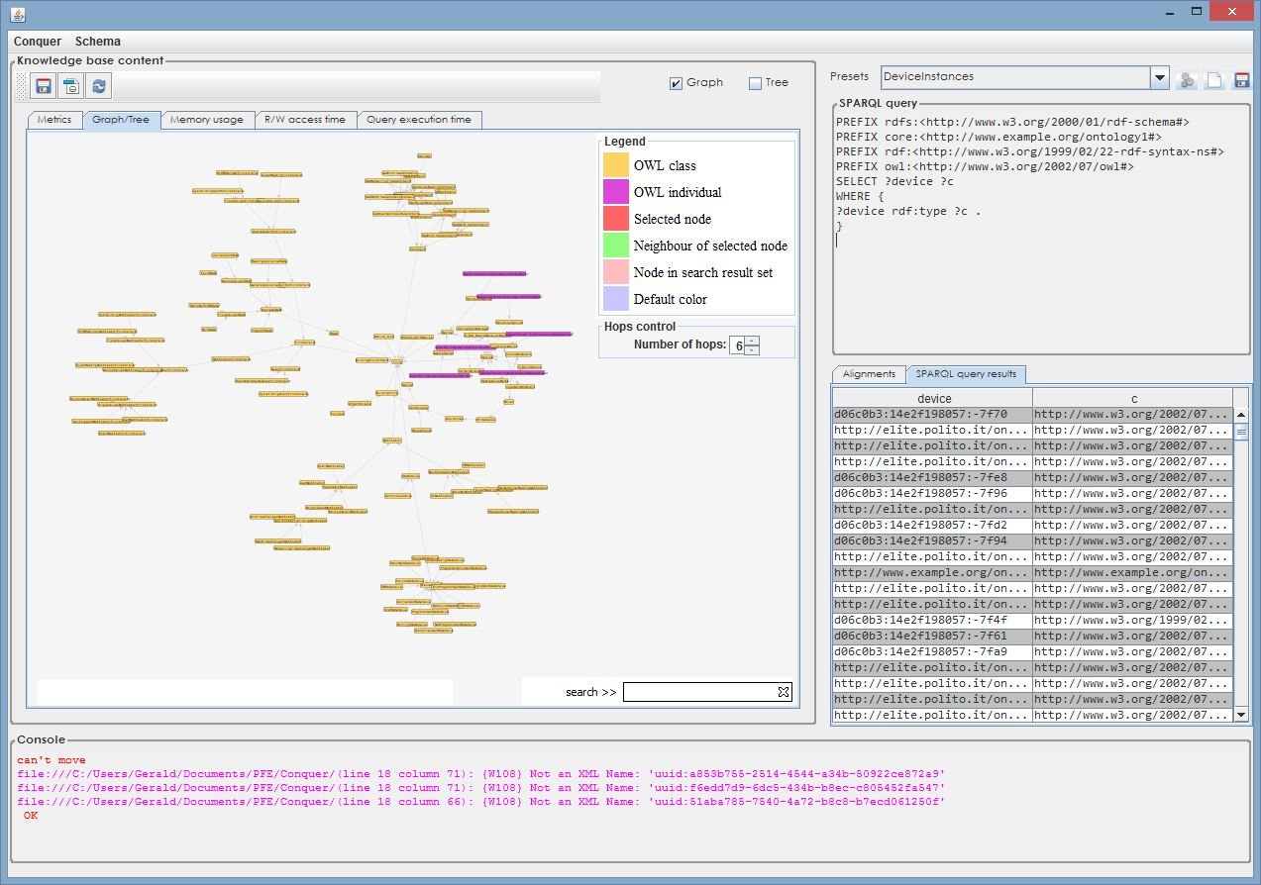
Knowledge base
Based on Conquer
Jena API
Pellet reasoner
Alignment API
Encapsulated as a web service for device (UPnP)
Control point
Content and metrics vizualization
SPARQL queries

Slide 17
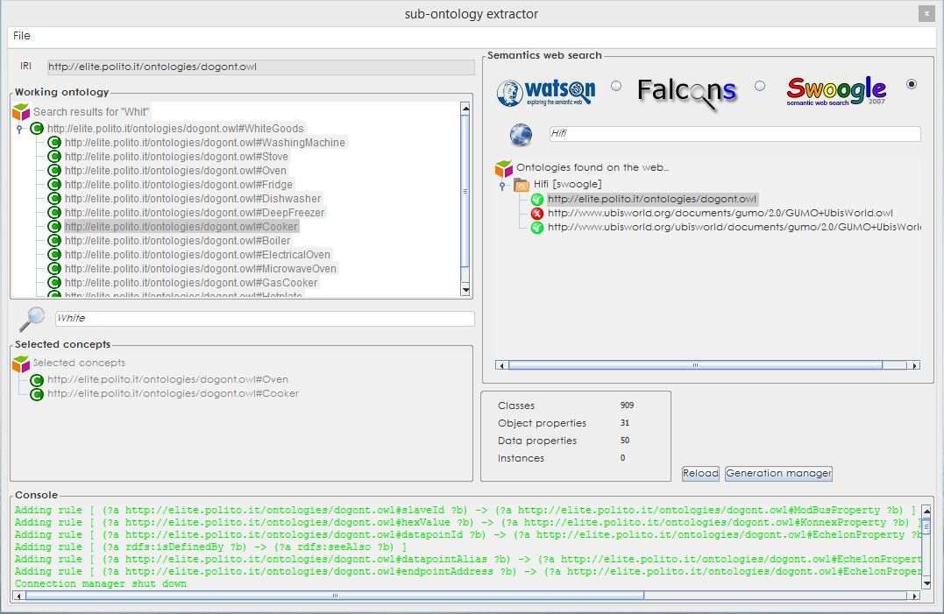
Sub-ontologies extractor (1/3)
Get ontologies from semantic web search engines
Select concepts to be extracted in sub-ontology

Slide 18
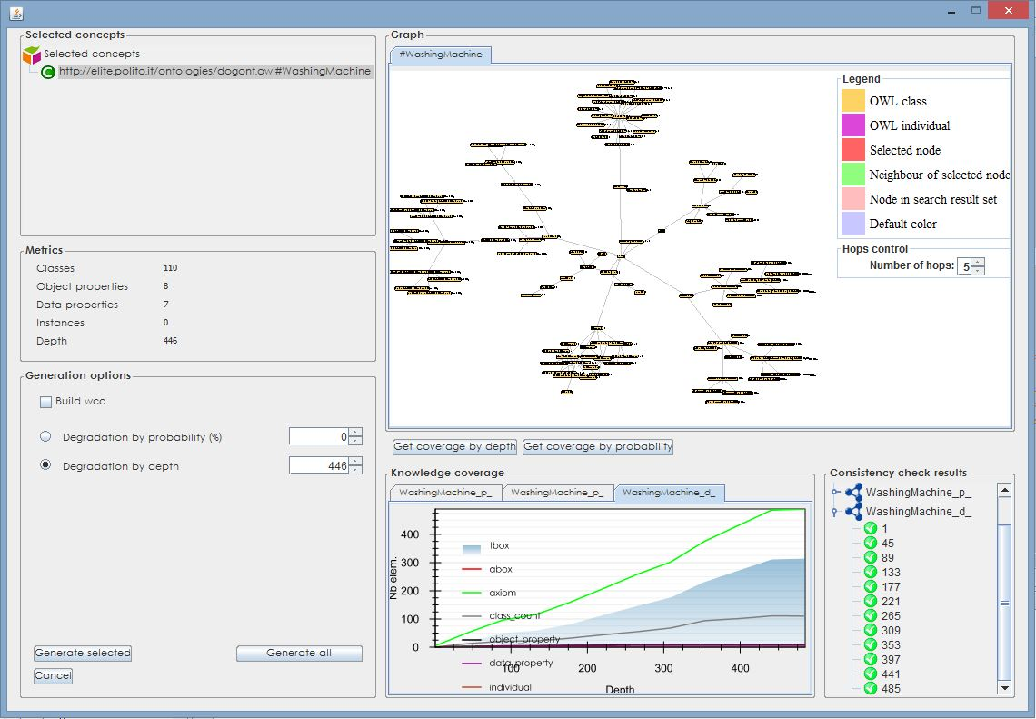
Sub-ontologies extractor (2/3)
Knowledge loss = f(depth)
Vizualize extracted sub-ontology
Sub-ontology degradation options

Slide 19
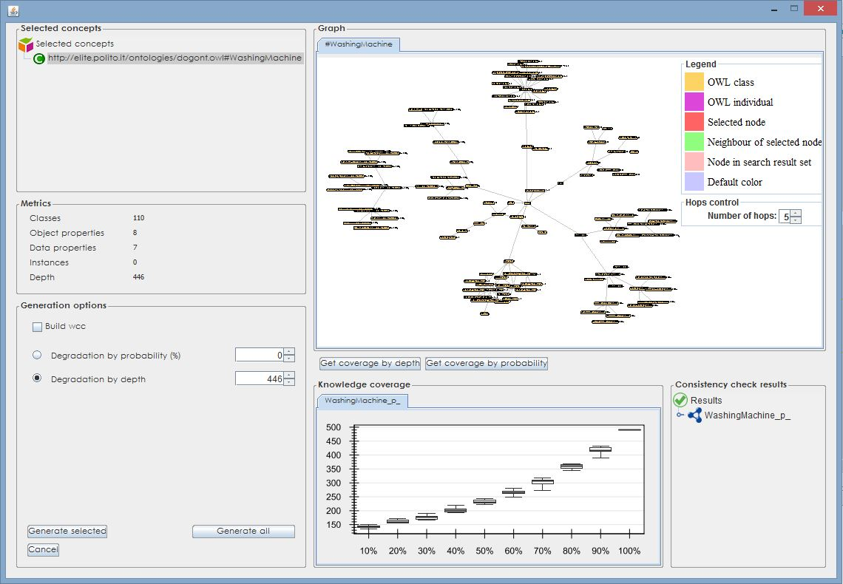
Sub-ontologies extractor (3/3)
Knowledge loss = f(probability)

